Slide 1
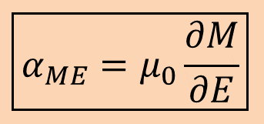
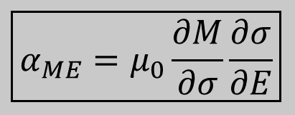
Multiferroic materials and composites
Multiferroic materials
P
M
Multiferroic
H
BiFeO₃
E
Ferroelectric
Multiferroic
and magnetoelectric
Ferromagnetic
$$\boxed{α_{ME}=μ_{0}\frac{∂M}{∂E}}$$
P, M
Multiferroic composites
E, H
Terfenol-D, FeGa
Magnetostrictive
PZN-PT, PMN-PT
Piezoelectric
Strain
$$\boxed{α_{ME}=μ_{0}\frac{∂M}{∂σ}\frac{∂σ}{∂E}}$$
3500 Oe → 6 kV/cm, PZN-PT/Terfenol-D
Liu, M. et al., J. Appl. Phys. 112, 063917 (2012)
Notes:
lead zinc niobate-lead titanate (PZN-PT), lead magnesium niobate-lead titanate (PMN-PT)

Slide 2
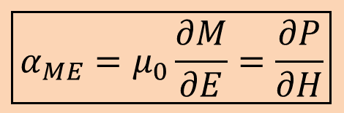


Multiferroic materials
Multiferroic materials can have intrinsic magnetoelectric coupling
E
$$\boxed{α_{ME}=μ_{0}\frac{∂M}{∂E}=\frac{∂P}{∂H}}$$
Piezoelectricity
P
Issues for
technological applications
Magnetoelectricity (intrinsic)
Room-temperature operation
Not enough magnetoelectric coupling
$$ε$$
M
$$σ$$
H
Magnetostriction
Notes:
Here, E H and sigma are electric field, magnetic field and stress, respectively and they can be applied externally
P M and epsilon are polarization, magnetization and strain, which are macroscopic observables
Here they can be intrinsic coupling between E and H but there are issue for technological applications

Slide 3

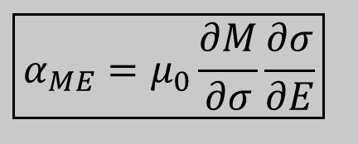

Multiferroic composites
E
Multiferroic heterostructures
Magnetostrictive
Piezoelectric
Strain
Piezoelectricity
P
Magnetoelectricity (intrinsic)
Enhanced magnetoelectric
coupling by strain
$$ε$$
M
Stress-mediated
$$σ$$
H
$$\boxed{α_{ME}=μ_{0}\frac{∂M}{∂σ}\frac{∂σ}{∂E}}$$
Magnetostriction

Slide 4

Magnetic thermal annealing
Lattice deformities can degrade material quality
It helps to eliminate structural imperfections
It reorients each spin along applied magnetic field, if the sample has deformed ferromagnetic lattice
Reorientation of the easy axis in a ferromagnetic material
Magnetic thermal annealing setup

Slide 5
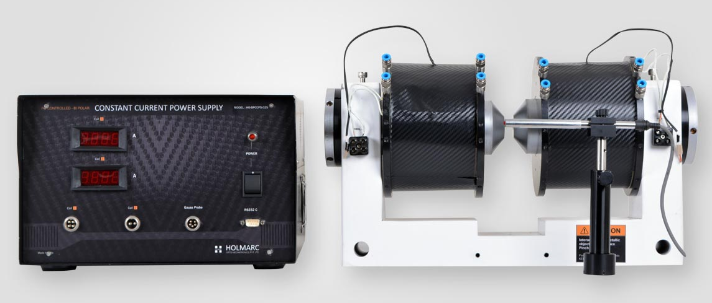
Electromagnet
H.C Oersted concluded that current carrying conductor produce magnetic field around it, and it obeys right hand thumb rule
Thumb directs direction of current
Four fingers directs magnetic field around it
Direction of magnetic field depends upon direction of current
Flux = No. of turns * input current

Slide 6
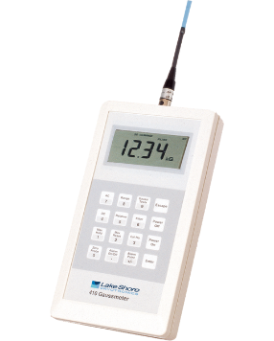
Gauss meter
Gaussmeter is an static electronic magnetic fields measurement device
Hall effect is conversion of magnetic field into Hall voltage
Electrons in magnetic field tries to move in perpendicular direction of applied magnetic field (Lorentz force)

